Slide 1
VOICE ASSISTANT FLUTTER RADIO APP
AKSHAYKUMAR M R
MES20MCA-2003
DR. GEEVAR C ZACHARIAS

Slide 2
TABLE OF CONTENTS
CONTENT | PAGE
Description About Project | 3
Modules | 4
Methodology | 5
Developing Environment | 15
Future Enhancement | 16
Project Plan | 17
User Story | 18
Product Backlog | 19
Sprint plans | 20
Sprint Actual | 22

Slide 3
VOICE ASSISTANT FLUTTER RADIO APP
Building multi station FM radio app using AI assistant ALAN. This is an Alan AI powered voice assistant FM radio app which can be used to play some music and also make some voice chat with Alan. This project, We show you how we can integrate Alan AI incredibly easily into a RADIO app. we have to use Flutter ( dart language ) for app development and integrate it with AI using ALAN. This project is an Radio application based on the AI Technology. This Radio can recognize your voice and reply to it also.

Slide 4
MODULES
USER:-
View FM stations
Voice Command
Voice Chat
Play Music

Slide 5
METHODOLOGY
Voice integration is the future. It enables applications to be accessible to everyone and is very mobile friendly. In this customer-centric era, user experience has become one of the topmost priority for customer based applications. That’s why developers are also focusing more on user interactions to make it as smooth as possible. When it comes to UX, AI( Artificial Intelligence ) has always been a good performer. Developers nowadays are using AI to enhance the UX of their applications. Voice-controlled interaction is one of them. I have used ALAN to bring the voice controlled AI features inside the application, audio players plugin to play the radios and VelocityX for the seamless UI. I used Flutter SDK, Alan SDK and Android SDK with Dart as preferred language. whenever some data or command is sent from the Alan server as a JSON object to client-side flutter code. It becomes handy when you try to do something in your flutter app as a response to your command. it is just an easy example of the implementation of a voice assistant in a flutter application.

Slide 6
ALAN AI
Alan AI is a complete voice AI platform. Alan is a conversational voice AI platform that lets you create an intelligent voice assistant for your app. It offers all necessary tools to design, embed and host your voice solutions. A powerful web-based IDE where you can write, test and debug dialog scenarios for your voice assistant or chat bot. Alan's lightweight SDKs to quickly embed a voice assistant to your app. Alan's AI-backend powered by the industry’s best Automatic Speech Recognition (ASR), Natural Language Understanding (NLU) and Speech Synthesis. The Alan Cloud provisions and handles the infrastructure required to maintain your voice deployments and perform all the voice processing tasks. just a simple 'HEY ALAN' would wake up the voice assistant.

Slide 7
VOICE PROCESSING :STEPS
Step 1:
Voice commands processing starts on the client side. The Alan Client SDK captures voice stream from the user’s device and sends the voice data to the Alan Cloud for processing.
Step 2:
Alan uses the Automatic Speech Recognition (ASR) engine and Speech-to-Text (STT) to get the user input and convert it to text segments.
Step 3:
With the help of Spoken Language Understanding (SLU) Alan evaluates the phrase patterns, draws the intent and meaningful words, such as location, date and time, from the phrase. For high accuracy of matching, Alan uses the Domain Language Model for your app.
Step 4:
Alan matches the phrase to a voice command in the Alan script. This is where Alan Machine Learning (ML) algorithms are leveraged. Each phrase is given a probability score, with ‘1’ being the most accurate match.
Step 5:
If Alan is supposed to give a response, it uses the Text-to-Speech (TTS) technology to synthesize speech that sounds natural.

Slide 8
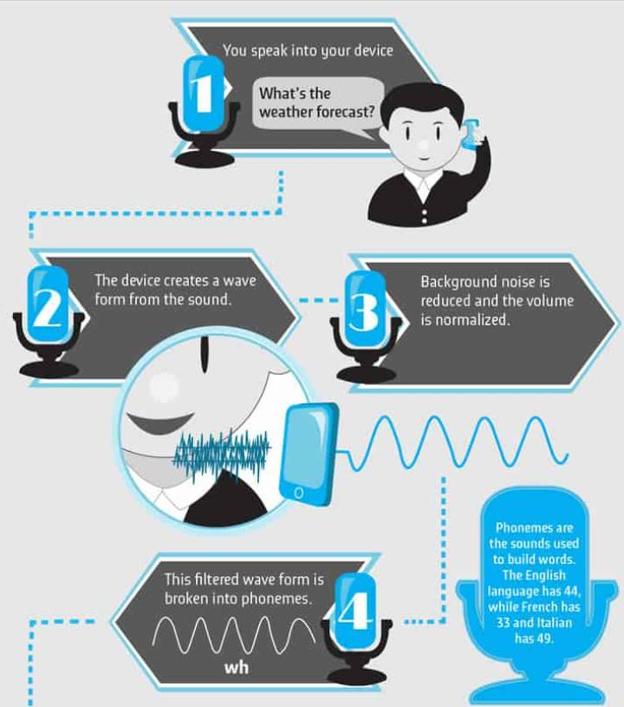
1.BASICS: AUTOMATIC SPEECH RECOGINITION (ASR) WORKS

Slide 9
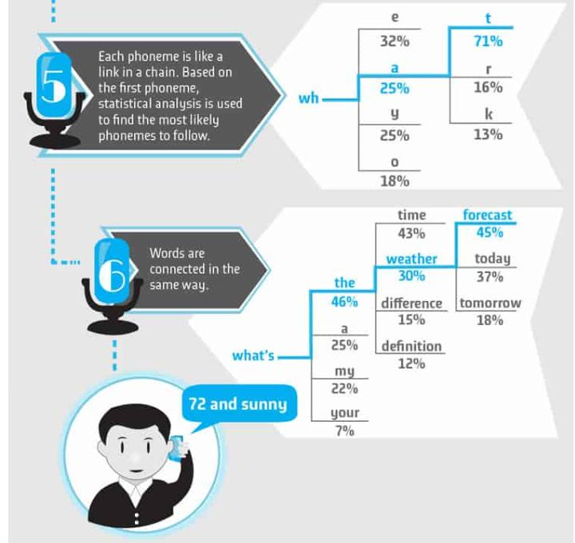

Slide 10
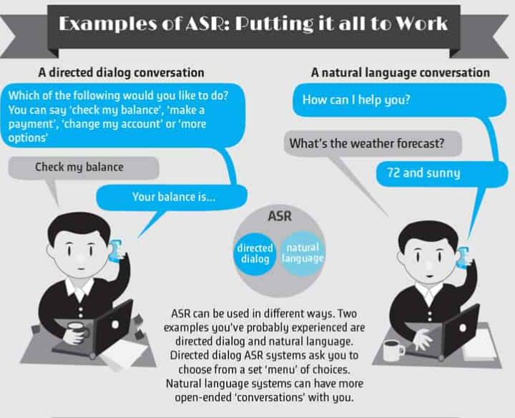

Slide 11
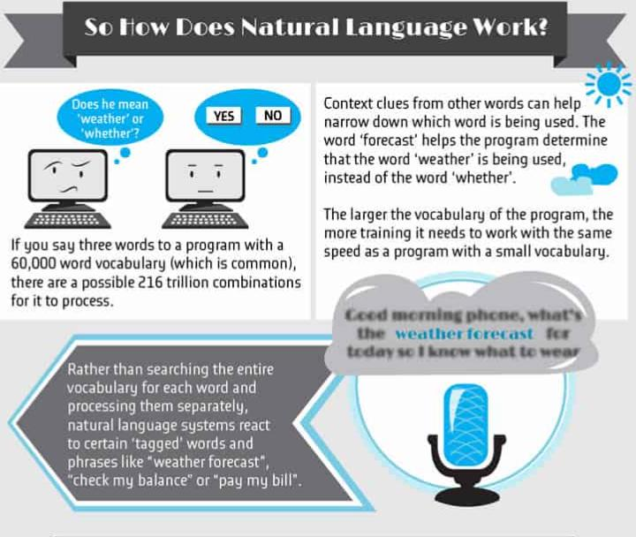

Slide 12
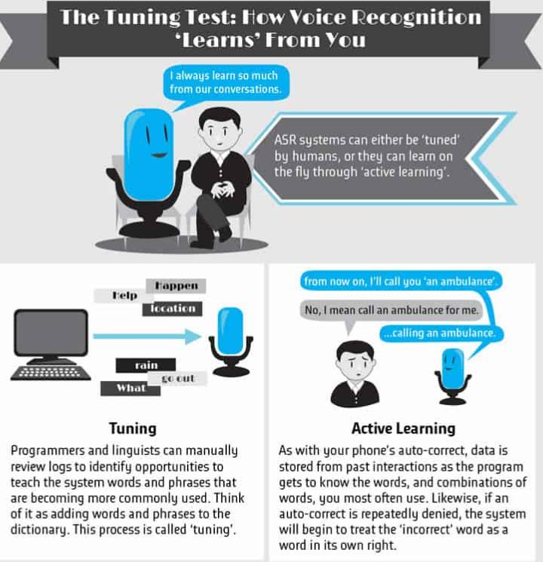

Slide 13
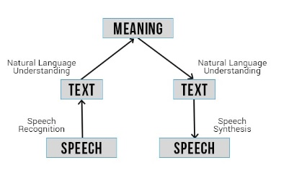
2. Natural language understanding (NLU)
Natural language understanding (NLU) is a subfield of natural language processing (NLP), which involves transforming human language into a machine-readable format.

Slide 14
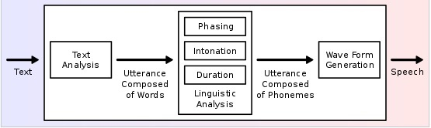
3.SPEECH SYNTHESIS
Speech synthesis is the artificial production of human speech. A computer system used for this purpose is called a speech computer or speech synthesizer, and can be implemented in software or hardware products. A text-to-speech (TTS) system converts normal language text into speech; other systems render symbolic linguistic representations like phonetic transcriptions into speech. The reverse process is speech recognition.

Slide 15
DEVELOPING ENVIRONMENT
Tools / Platform, Hardware and Software Requirements:
Hardware specification:
Processor : Intel Pentium Core i3 and above
Primary Memory : 4 GB RAM and above
Storage : 500 GB hard disk and above
Display : VGA Color Monitor
Key Board : Windows compatible
Mouse : Windows compatible
Software specification:
Language: Dart
Framework: Flutter
Operating system : windows 7 and above
IDE : Visual Studio Code
Others : JS,ALAN STUDIO

Slide 16
FUTURE ENHANCEMECT
Improved Voice Recognition
Volume control and start/pause using earphones
Play local files
Improved UI
Music Sharing
Add more FM stations

Slide 17
PROJECT PLAN
User Story ID | Task Name | Start Date | End Date | Days | Status
1 | Sprint 1 | 22/04/2022 | 08/05/2022 | 6 | Completed
2 | Sprint 2 | 09/05/2022 | 23/05/2022 | 5 | Completed
3 | Sprint 3 | 24/05/2022 | 09/06/2022 | 5 | Completed
4 | Sprint 4 | 10/06/2022 | 30/06/2022 | 6 | Completed

Slide 18
USER STORY
User Story ID | As a type of User | I want to <perform some task> | So that I can < Achieve Some Goal>
1 | User | UI design | User Interface
2 | User | Integrating Audio Player | Audio Player
3 | User | Build Alan AI Project | Voice Assistant
4 | User | Adding FM stations | Add FM Stations

Slide 19
PRODUCT BACKLOG
User story ID | Priority <High/Medium/Low> | Size (Hours) | Sprint <#> | Status <Planned/In progress/Completed> | Release Date | Release Goal
1 | Medium | 10 | 1 | Completed | 08/05/2022 | UI design
2 | Medium | 10 | 2 | Completed | 23/05/2022 | Integrating Audio Player
3 | Medium | 10 | 3 | Completed | 09/06/2022 | Build Alan AI Project
4 | Medium | 10 | 4 | Completed | 30/06/2022 | Adding FM Stations

Slide 20
SPRINT PLANS
Backlog Item | Status and Completion date | Original Estimate in hours | Day 1 | Day 2 | Day 3 | Day 4 | Day 5 | Day 6 | Day 7 | Day 8 | Day 9 | Day 10 | Day 11
User story #1 |  |  | hrs | hrs | hrs | hrs | hrs | hrs | hrs | hrs | hrs | hrs | hrs
UI Design | 08/05/2022 | 10 | 2 | 3 | 3 | 2 | 3 | 2 | 0 | 0 | 0 | 0 | 0
User story #2
Integrating Audio Player | 23/05/2022 | 10 | 0 | 0 | 0 | 0 | 0 | 0 | 3 | 2 | 3 | 2 | 2
Total |  | 50 | 2 | 3 | 3 | 2 | 3 | 2 | 3 | 2 | 3 | 2 | 2

Slide 21
SPRINT PLANS
Backlog Item | Status and Completion date | Original Estimate in hours | Day 12 | Day 13 | Day 14 | Day 15 | Day 16 | Day 17 | Day 18 | Day 19 | Day 20 | Day 21 | Day 22
User story #3 |  |  | hrs | hrs | hrs | hrs | hrs | hrs | hrs | hrs | hrs | hrs | hrs
Build Alan AI Project | 09/06/2022 | 10 | 3 | 3 | 3 | 2 | 2 | 0 | 0 | 0 | 0 | 0 | 0
User story #4
Add FM Stations | 30/06/2022 | 10 | 0 | 0 | 0 | 0 | 0 | 2 | 1 | 2 | 1 | 2 | 2
Total |  | 50 | 3 | 3 | 3 | 2 | 2 | 2 | 1 | 2 | 1 | 2 | 2

Slide 22
SPRINT ACTUAL
Backlog Item | Status and Completion Date | Original Estimate in hours | Day 1 | Day 2 | Day 3 | Day 4 | Day 5 | Day 6 | Day 7 | Day 8 | Day 9 | Day 10 | Day 11 | Completed <Y/N>
User story #1 |  |  | hrs | hrs | hrs | hrs | hrs | hrs | hrs | hrs | hrs | hrs | hrs
UI Design | 08/05/2022 | 15 | 2 | 3 | 3 | 2 | 3 | 2 | 0 | 0 | 0 | 0 | 0 | Y
User story #2
Integrating Audio Player | 23/05/2022 | 12 | 0 | 0 | 0 | 0 | 0 | 0 | 3 | 2 | 3 | 2 | 2 | Y
Total |  | 50 | 2 | 3 | 3 | 2 | 3 | 2 | 3 | 2 | 3 | 2 | 2

Slide 23
SPRINT ACTUAL
Backlog Item | Status and Completion date | Original Estimate in hours | Day 12 | Day 13 | Day 14 | Day 15 | Day 16 | Day 17 | Day 18 | Day 19 | Day 20 | Day 21 | Day 22 | Completed <Y/N>
User story #3 |  |  | hrs | hrs | hrs | hrs | hrs | hrs | hrs | hrs | hrs | hrs | hrs
Build Alan AI Project | 09/06/2022 | 13 | 3 | 3 | 3 | 2 | 2 | 0 | 0 | 0 | 0 | 0 | 0 | Y
User story #4
Add FM Stations | 30/06/2022 | 10 | 0 | 0 | 0 | 0 | 0 | 2 | 1 | 2 | 1 | 2 | 2 | y
Total |  | 50 | 3 | 3 | 3 | 2 | 2 | 2 | 1 | 2 | 1 | 2 | 2

Slide 24
Thank You

